Slide 1
Novel System Architectures for Semantic Based
Sensor Networks Integraion
Zoran Babovic, zbabovic@etf.rs
Veljko Milutnovic, vm@etf.rs
The School of
the Electrical Engineering, University of Belgrade

Slide 2
Introduction
The progress in the sensing and wireless technology implies proliferation and deployment of
various sensor nodes devices
Sensor Web – the vision of
heterogeneous sensor networks integration on the Web
Semantic Based Integration –
Ability of independent systems to
exchange, understand, interpret, and process data
produced by other systems based on semantic data
Semantic Sensor Web is a platform that
enables possibility for providing more complex services by supplying context-related information
with the raw sensor data

Slide 3
Challenges of Sensor Networks Integration
Basic organization
Scalability
Sensor data sources heterogenity
Flexibility of supported sensor networks
SN capability awareness
SN management and actuation functions
Ontologies and level of applied semantics
The data representation model
Query language
Knowledge inference
Application/Service interface and data format
Service discovery
Service composition
Quality of service and information
Security

Slide 4
Clasiffication Criteria for Existing Approaches
Two main available approaches:
  Bottom-up – Sensor Networks Oriented Approaches
  Top-down - Application Oriented Approaches
Sensor Networks Oriented Approaches include:
  Database Centered
  The Query Translation
  Sensor Virtualization
Application Oriented Approaches include:
  The Service-Oriented Architecture
  Service-Composition Oriented Approach
  The Rule Based Data Transformation
  The Agent Based Systems

Slide 5
Database Centered Solutions
Basic characteristics:
  A database is a central hub of all collected sensor data
  All search and manipulation of sensor data
  are performed over the database
Challenges:
  How to map heterogeneous sensor data to database schema
  Support for real-time data provision
  Scalability
Advances:
  The ability for applying data mining algorithms over stored data
  in order to extract additional knowledge
Non-Semantic Solutions
  Cougar, Cornel University in 2001
  SenseWeb, Microsoft Research, 2008
Semantic Based Solutions
  E3SN, University of Georgia, 2006

Slide 6
Query Translation Approaches
Basic characteristics:
  Users query are transformed to the target query language of
  certain sensor data source
  The results of native queries should be assembled into
  the target data format
Challenges:
  Maintenance of information of available data sources, primarily the native query language of certain data source, format and nature of produced data, but it may also include information about sensors capabilities, network topology, power constrains for better query optimization
  Potential performance drawback – two data conversion per one request
Only Semantic Solutions:
  CSIRO SSN, by CSIRO ICT Centre, Australia in 2008
  SPARQL_{STREAM,} Polytechnic University at Madrid and University of Manchester, 2010
  SemSorGrid4Env, EU FP7, 2011

Slide 7
Sensor Virtualization Approaches
Basic Characteristics
  Sensors and other devices are virtualized with an abstract data model
  Applications are provided with the ability to directly interact
  with such abstractions using the specified interface
  Multiple levels of sensor data formats might coexist
  depending on the user needs
Challenges:
  Produced data streams must comply with
  the commonly accepted format that should enable interoperability
Non-Semantic Solutions
  GSN (Global Sensor Network), EPFL, Switzerland in 2006
Semantic Solutions
  SENSEI, EU FP7, 2010
  IoT (Internet of Things), EU FP7, 2012

Slide 8
Service-Oriented Architectures
Basic Characteristics
  Provide standard service interface with
  defined methods and data encodings for
  obtaining sensor observations and measurements
  There could be offered functions for
  subscription on sensor data, performing actuation functions and others
  Dominant interaction model is request-reply, and
  to a lesser extent the event-based delivery of sensor data
Challenges
  How to fuse stream-based sensor data with
  aquisitional and archived sensor data
Non-Semantic Solutions
  TinyREST, by Fraunhofer and Samsung in 2005
  SWE, by OGC (Open Geospatial Consortium) in 2006
Semantic Solutions
  SemSOS, by Wright State University in 2009

Slide 9
Service-Composition Approaches
Basic Characteristics
  Offer to users the ability to define arbitrary services or data streams with specific characteristic they are interested in
  The system will try to compose such a data flow by
  applying specific processing over appropriate data sources,
  which will result in producing a data stream that
  conforms to the requested specification
Challenges:
  How to describe sensor data sources and processing elements in order
  to enable efficient reasoning and composing of desired data streams
Non-Semantic Solutions
  Hourglass by Harvard University in 2004
Semantic Solutions
  SONGS by Microsoft in 2005
  System S Middleware by IBM in 2007

Slide 10
Rule Based Data Transformation Approaches
Basic Characteristics:
  Mapping functions are based on the relationships between
  the concepts captured in the ontological representation of
  the domain model and sensor data observations and measurements
  Data are transformed from lower level formats to
  semantic-based representations that enable
  semantic search over available data and
  applying of reasoning algorithms
Challenges:
  An appropriate information model should be designed in order to
  cover various application domains and sensor devices
Semantic Based Solutions
  Semantic Based Data Fusion by University of Toronto in 2007
  Data Transformation by Mapping Rules by National Technical University of Athens in 2008
  SWASN by Ericsson in 2008

Slide 11
Agent Based Systems
Basic Characteristics:
  There are several types of agents,
  software components capable of performing specific tasks, which collaboratively achieve desired functionalities
  Typically, agents belong to one of several layers depending on the type of functionalities they are responsible for
  Agents from upper layers employ agents from lower layers
Challenges
  How to model agent processing capabilities and
  internal data formats
Non-Semantic Solutions
  IrisNet by Intel and Carnegie Mellon University in 2003
  SWAP, by ICT for Earth Observation Research Group in 2006

Slide 12
Comparison
Scalability: The most scalable approach is
directory based approach used in
sensor virtualization architectures
Users’ flexibility: Most comfortable approaches
from users’ perspective are
service-composition architectures
Information model: The most comprehensive information model has been proposed in
large EU FP7 Projects Sensei, IoT, and SemSor4Grid based on the W3C’s SSN Ontology
Application interface: The REST interface is
the most efficient application interface
implemented in many solutions

Slide 13
Authors’ research efforts
Traditional RDBMS fail in supporting the management of
high volume of sensor data provided by multiple data providers
and huge number of Internet users
NoSQL database systems offer high data availability
while maintaining petabytes of data
distributed over thousands of commodity machines
Column stores are widely used for Internet scale applications by Google, Facebook, Twitter and others
We have considered a column store distributed repository for
keeping obtained sensor data represented through RDF, and performing search over such data using appropriate indices
This platform can be used for publishing Linked Sensor Data, following principles of Linked Data
Our prototype is based on the HBase column store
built on the top of the Hadoop

Slide 14
Mapping of RDF sensor data to column store
In column stores, there is no strict schema for columns which can be dynamically added or removed
Sensor data are represented as triples <s, p, o>
using RDF
How to support all triple search patterns ?
Subject Centered Indexed Table: one subject per row with multiple predicates mapped as columns
Predicate Index Table: <po_s> type of index, where predicate_object is a row key,
and a subject as column key
Separate table for keeping spatial data index
Temporal information of sensor observations are coded as URI concatenation with the timestamp

Slide 15
The Architecture based on the column store
Ability of applying distributed multiple processing on
sensor data using MapReduce
Users are able to subscribe on either the data from the sensor data source or to complex data streams published by processing elements
Spatial-temporal search is improved using separate index structures

Slide 16
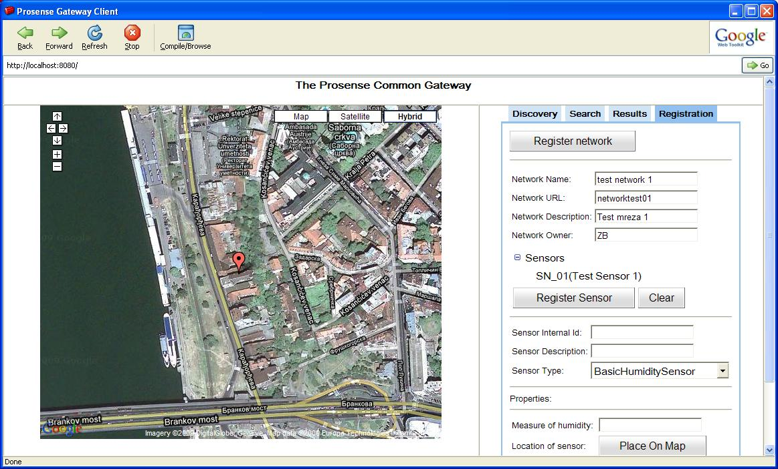
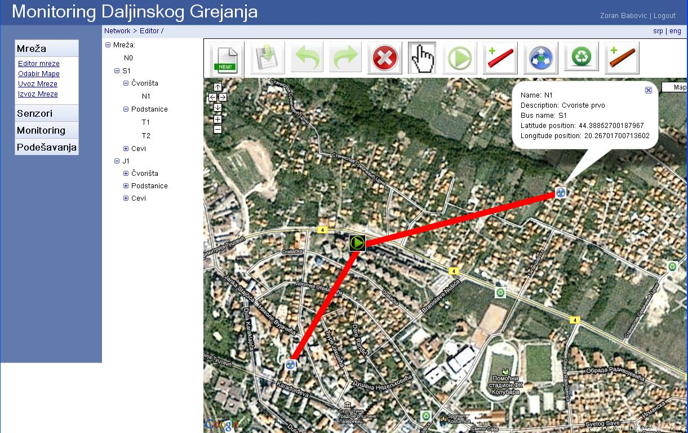
Sensor Web Applications
Public District Heating Monitoring System
Semantic sensor data search

Slide 17
Future research directions
Publications of sensor data as
linked resources using XLINK mechanism
Some researchers investigate extensions of
available semantic query languages
Creation of a flexible information model that
will satisfy needs of many sensor application scenarios
Investigation of efficient distributed structures suitable for managing spatial-temporal characteristic of
huge sensor data volume
Data mining and processing of Big Sensor Data

